Slide 1
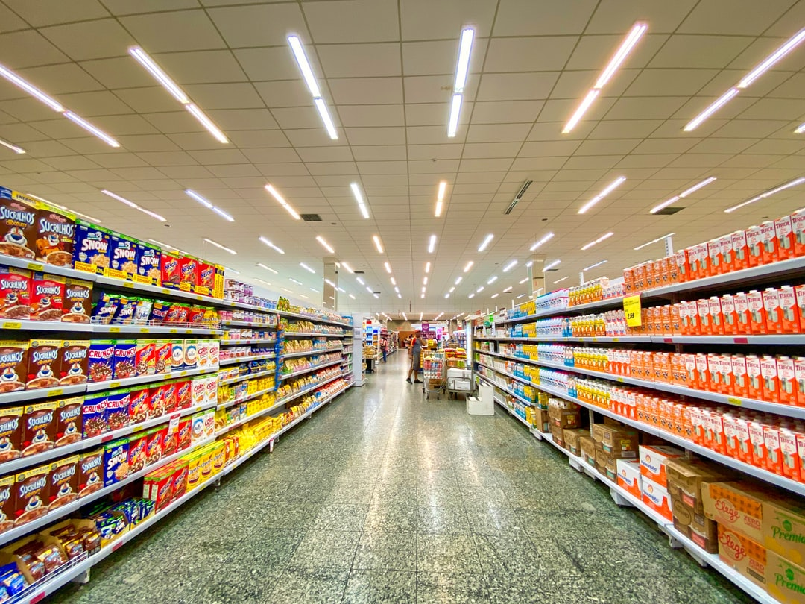
“Retail Management System”
The project uses the concept of “Inventory Management system” and applies it to a retail mart and makes it a customer facing interface.
Using this software a customer would have the facility to directly check for the product and know if they will find or not what they are looking for. This will save a lot of time of the costumers.

Slide 2
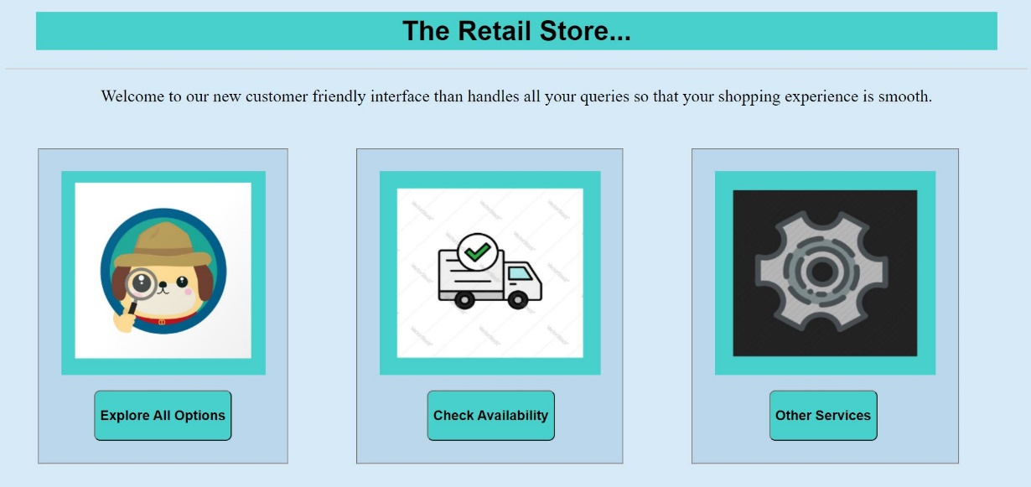
It has a very simple and easy to navigate interface so that it can be used by everyone.

Slide 3
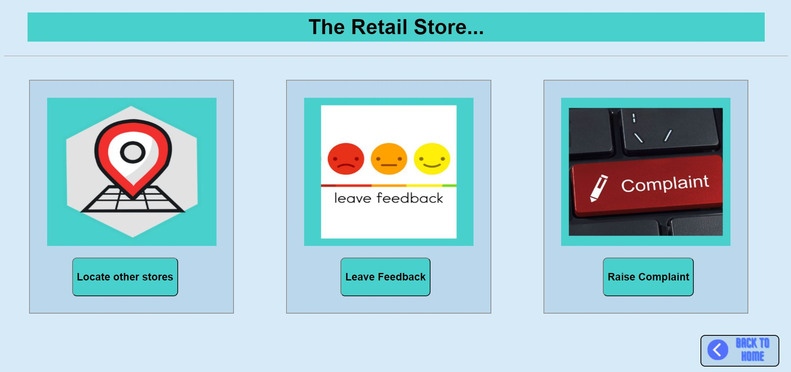
It can also be used to handle other tasks like feedback and complaint system and many other miscellaneous queries/problems faced by customers.

Slide 4
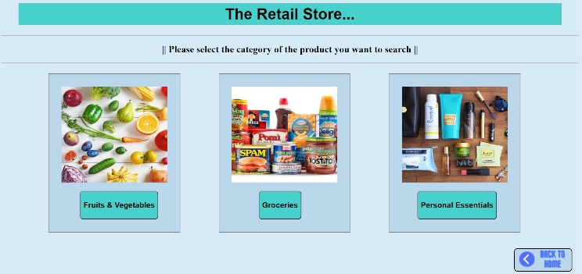
A customer can either search for a specific product that he/she wants OR explore all the options available in a specific category.

Slide 5
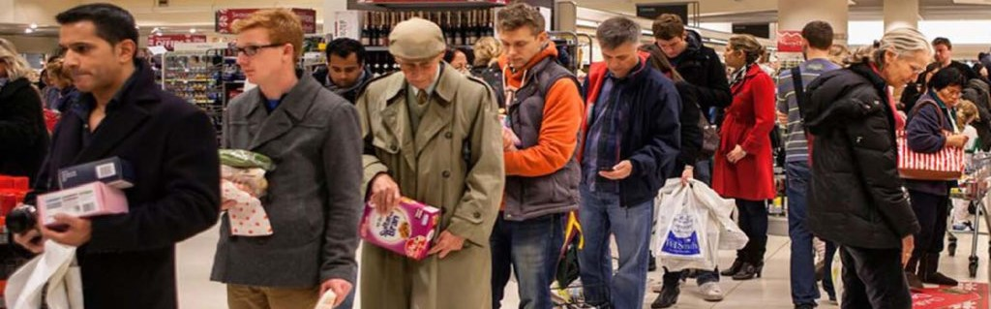
The further future implementation of the project can be - having a billing facility where the customers can themselves scan their purchases and pay the bill through online mode. This will greatly save time of customers as they will not have to line up in long queues.

Slide 6
Thankyou

